Slide 1
Assessing RNAseq with RNAseq_plots.R
By: Chris Gonzalez

Slide 2
Outline
What is RNAseq?
Differential Gene Expression
General workflow
Assessing RNAseq in R
Available packages
case example: hagfish gene expression

Slide 3
What is RNA-seq?
The Central Dogma of Biology
DNA
mRNA
Protein
gene transcribed (“expressed”)
transcript translated
Different cells / tissues express different genes

Slide 4
What is RNA-seq?
The Central Dogma of Biology
DNA
mRNA
Protein
gene transcribed (“expressed”)
transcript translated
Different cells / tissues express different genes
RNAseq measures / identifies differential gene expression between samples

Slide 5
What is RNA-seq?
The Central Dogma of Biology
DNA
mRNA
Protein
gene transcribed (“expressed”)
transcript translated
Different cells / tissues express different genes
RNAseq measures / identifies differential gene expression between samples

Slide 6
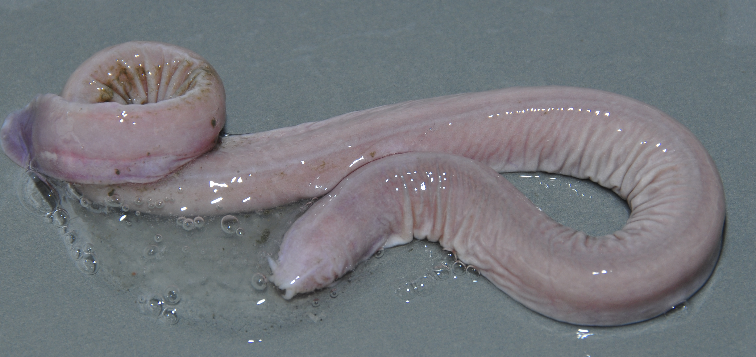
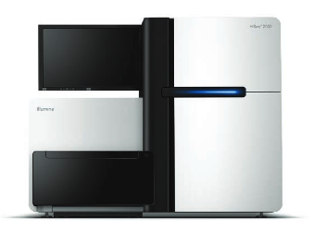


RNA-seq Workflow
reads
https://s2r.iucnredlist.org/sis2_images/2095949994.jpg
http://support.illumina.com
contig
Extract mRNA / sample
Make & sequence sample libraries
Use each library’s reads to make contig assembly
Skin
cells
Skin library
Barbel library
Barbel
Cells
Assembly of expressed hagfish transcripts

Slide 7
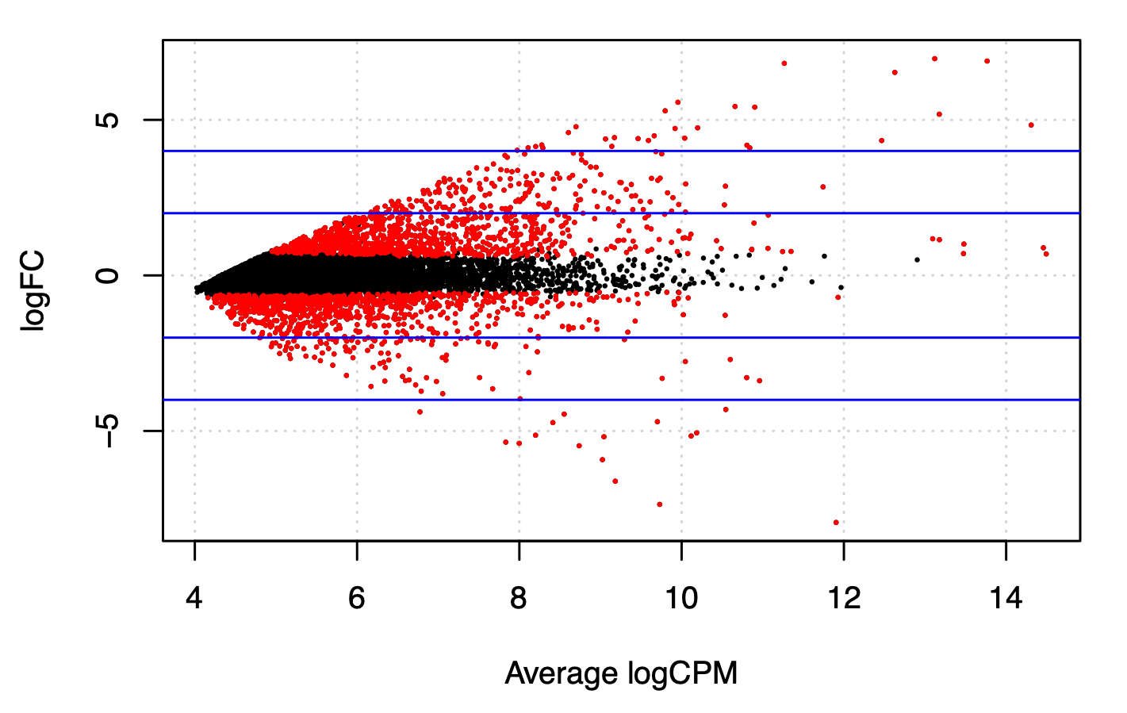
RNA-seq Workflow
Gene 1
Gene 1
barbel
reads
Skin
reads
Map each sample’s reads to reference or assembly (we use Salmon)
Assess differential gene expression between skin vs barbel
Lets organize mapping data to prepare for RNAseq assessment

Slide 8
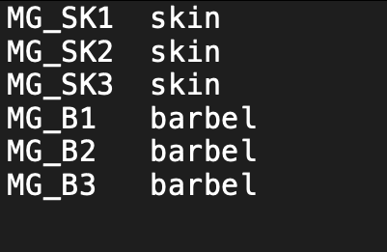
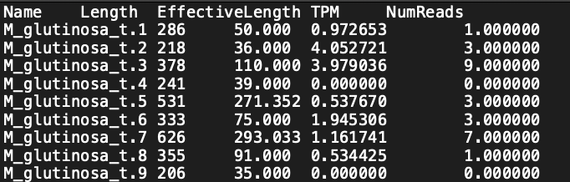
Understanding input data
(Rstudio, Demo_Data)
File correlating sample library name with tissue type
libraries.tsv
File containing mapped reads expression data
6 Salmon mapping files in mapping directory
“quant.sf” file in ./mapping/sample_name/quant.sf
Step #1 in Rstudio; ensure libraries and file path are in order

Slide 9
Assessing RNAseq
Four most popular RNAseq analysis programs (McDermaid et. al., 2019)
EdgeR
Cuffdiff/Cuffdiff2
DESeq2
limma
RNAseq_plots uses EdgeR functions

Slide 10
Running RNAseq_plots
Help menu and basic instructions
./RNAseq_plots.R –h
Packages & Libraries
BioConductor (BiocManager)
ggplot2
tidyr
- tximport, edgeR
ggrepel

Slide 11
Running RNAseq_plots
Help menu and basic instructions
./RNAseq_plots.R –h
Packages & Libraries
BioConductor (BiocManager)
ggplot2
tidyr
- tximport, edgeR
ggrepel
Syntax:
./RNAseq_plots.R <libraries.tsv> <-graph_option> <baseline_name> <assessed_name>
Demo Syntax:
./RNAseq_plots.R <libraries.tsv> <-all> <skin> <barbel>

Slide 12
RNAseq_plots operations
Dataframe Reading & Prep
Identifying libraries, library categories, and quant.sf file paths
Assessing Differential Gene Expression
tximport, edgeR
Plotting
ggplot, ggrepel, tidyr

Slide 13
Assessing Differential Gene Expression
Import salmon read data (tximport)
Filter transcripts according to > 10.0 CPM
DGEList() makes DGE object for EdgeR functions
Normalize libraries (calcNormFactors())
Calculate common dispersion (estimateCommonDisp())
Calculate tagwise dispersion (estimateTagwiseDisp())
prior.n = 50 / (# of samples — # of categories)
Calculate exact test (estimateTagwiseDisp())
Interpret exact test results as up/down regulated (decideTestsDGE())

Slide 14
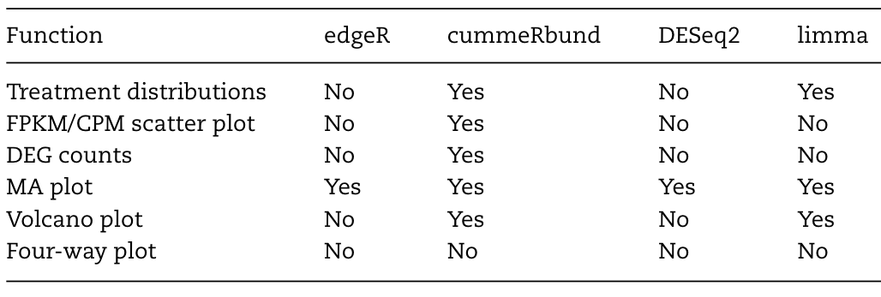
Major types of RNAseq Visuals
Major types of RNAseq analyses
(McDermaid et. al., 2019)
Most programs do not do all analyses
Program plotting functions convenient, but may not save raw data for future reference
RNAseq_plots uses ggplot2 and saves all raw data tables

Slide 15
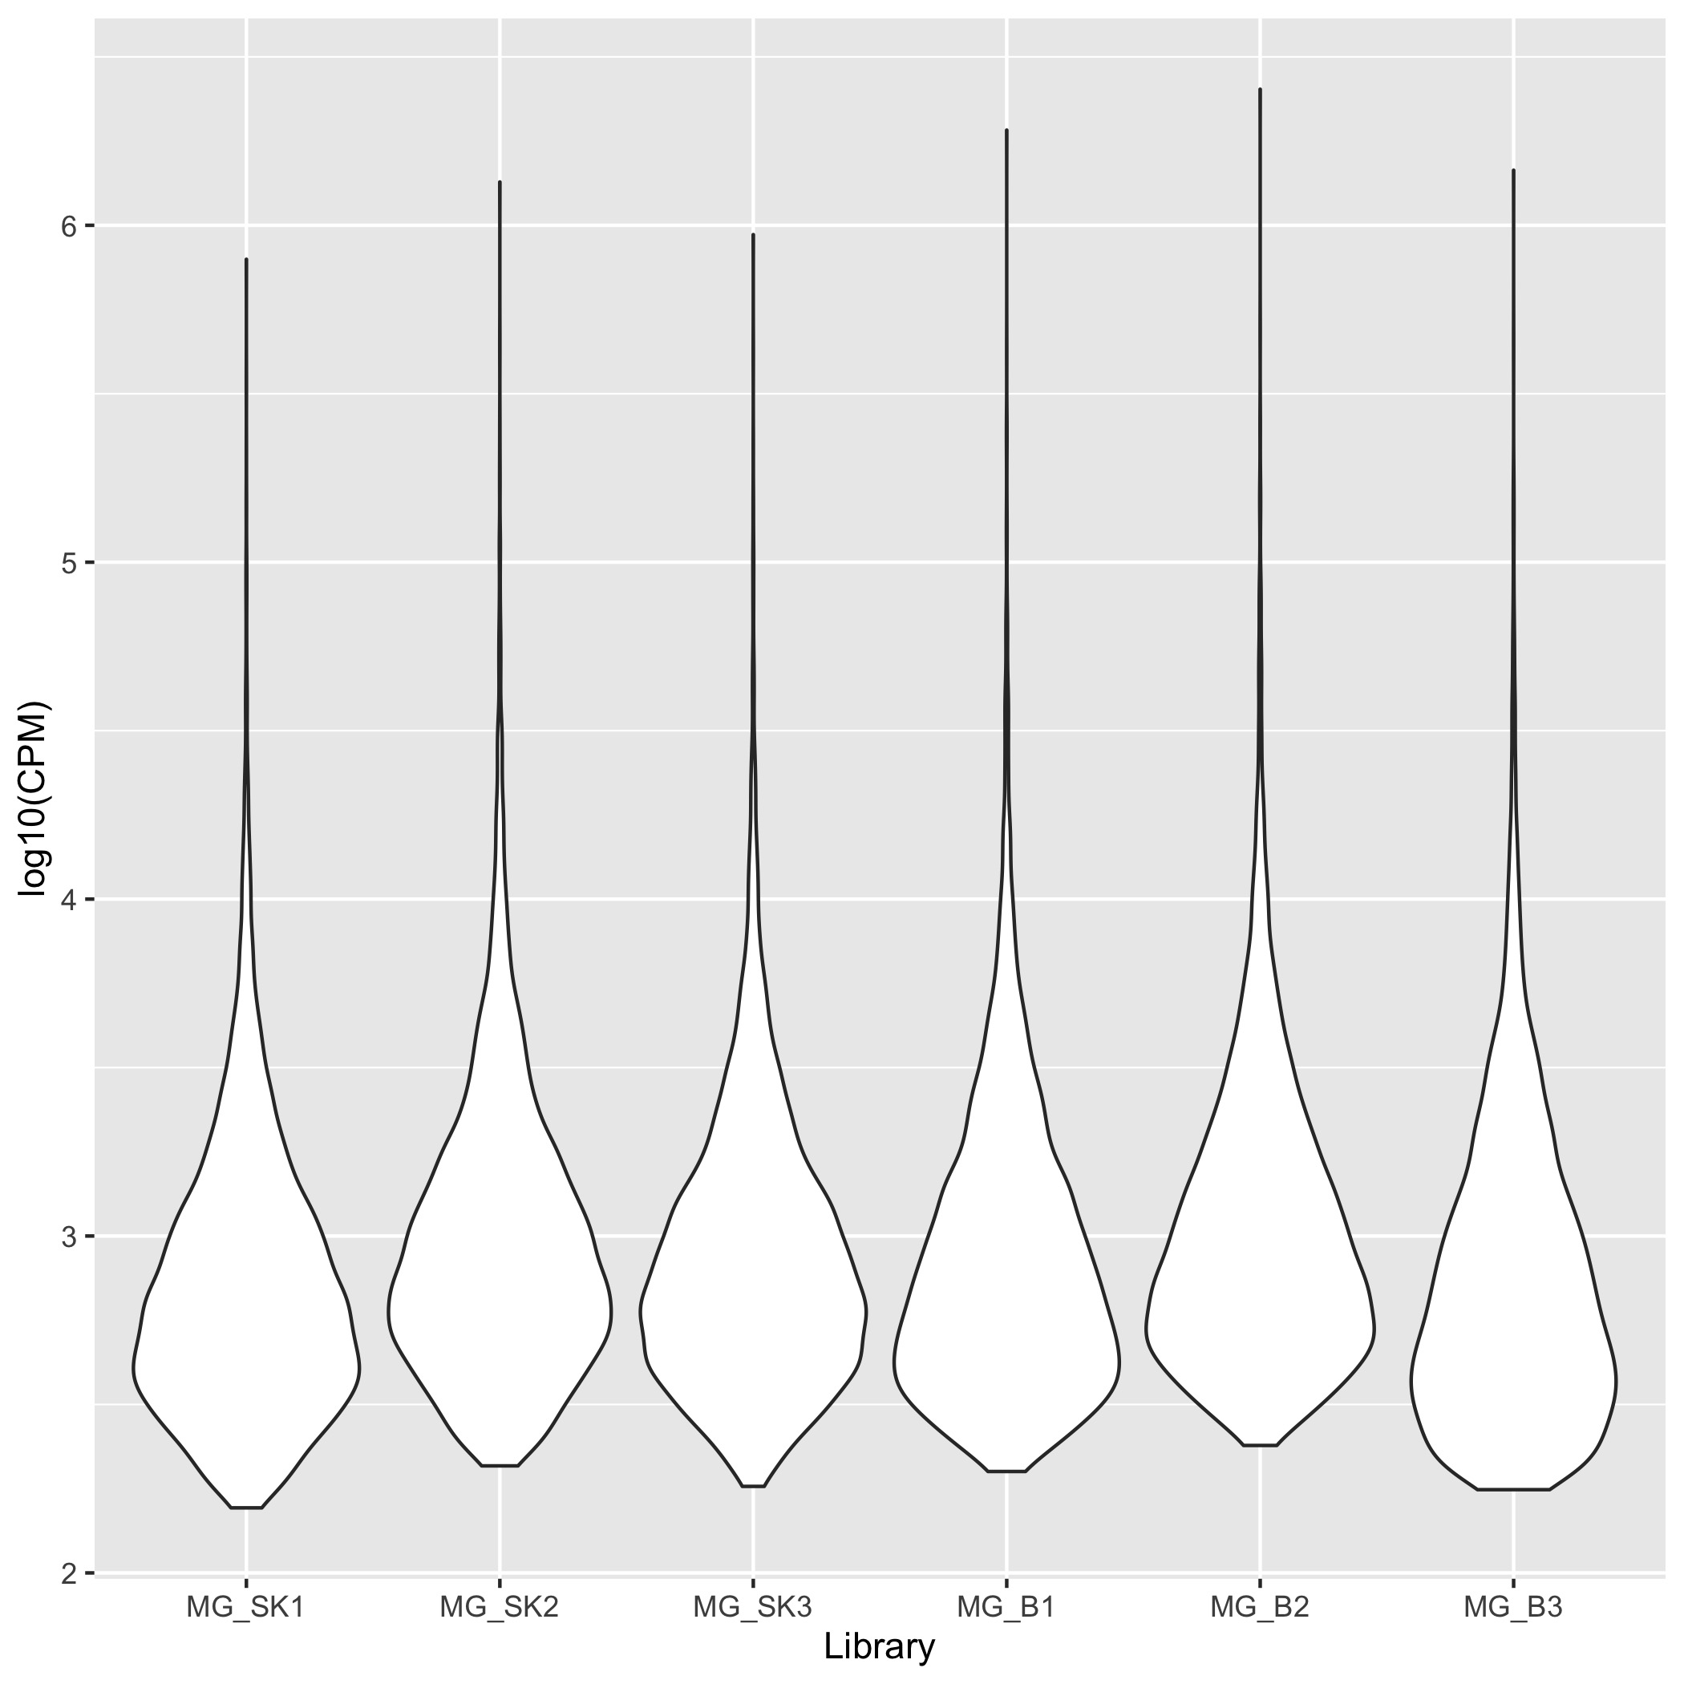
RNAseq Visuals: Quality (RStudio)
Read Distribution Plot
Takes log10 of DGE object CPM counts
Shows distribution of CPMs per library
IDs any outlier / questionable samples

Slide 16
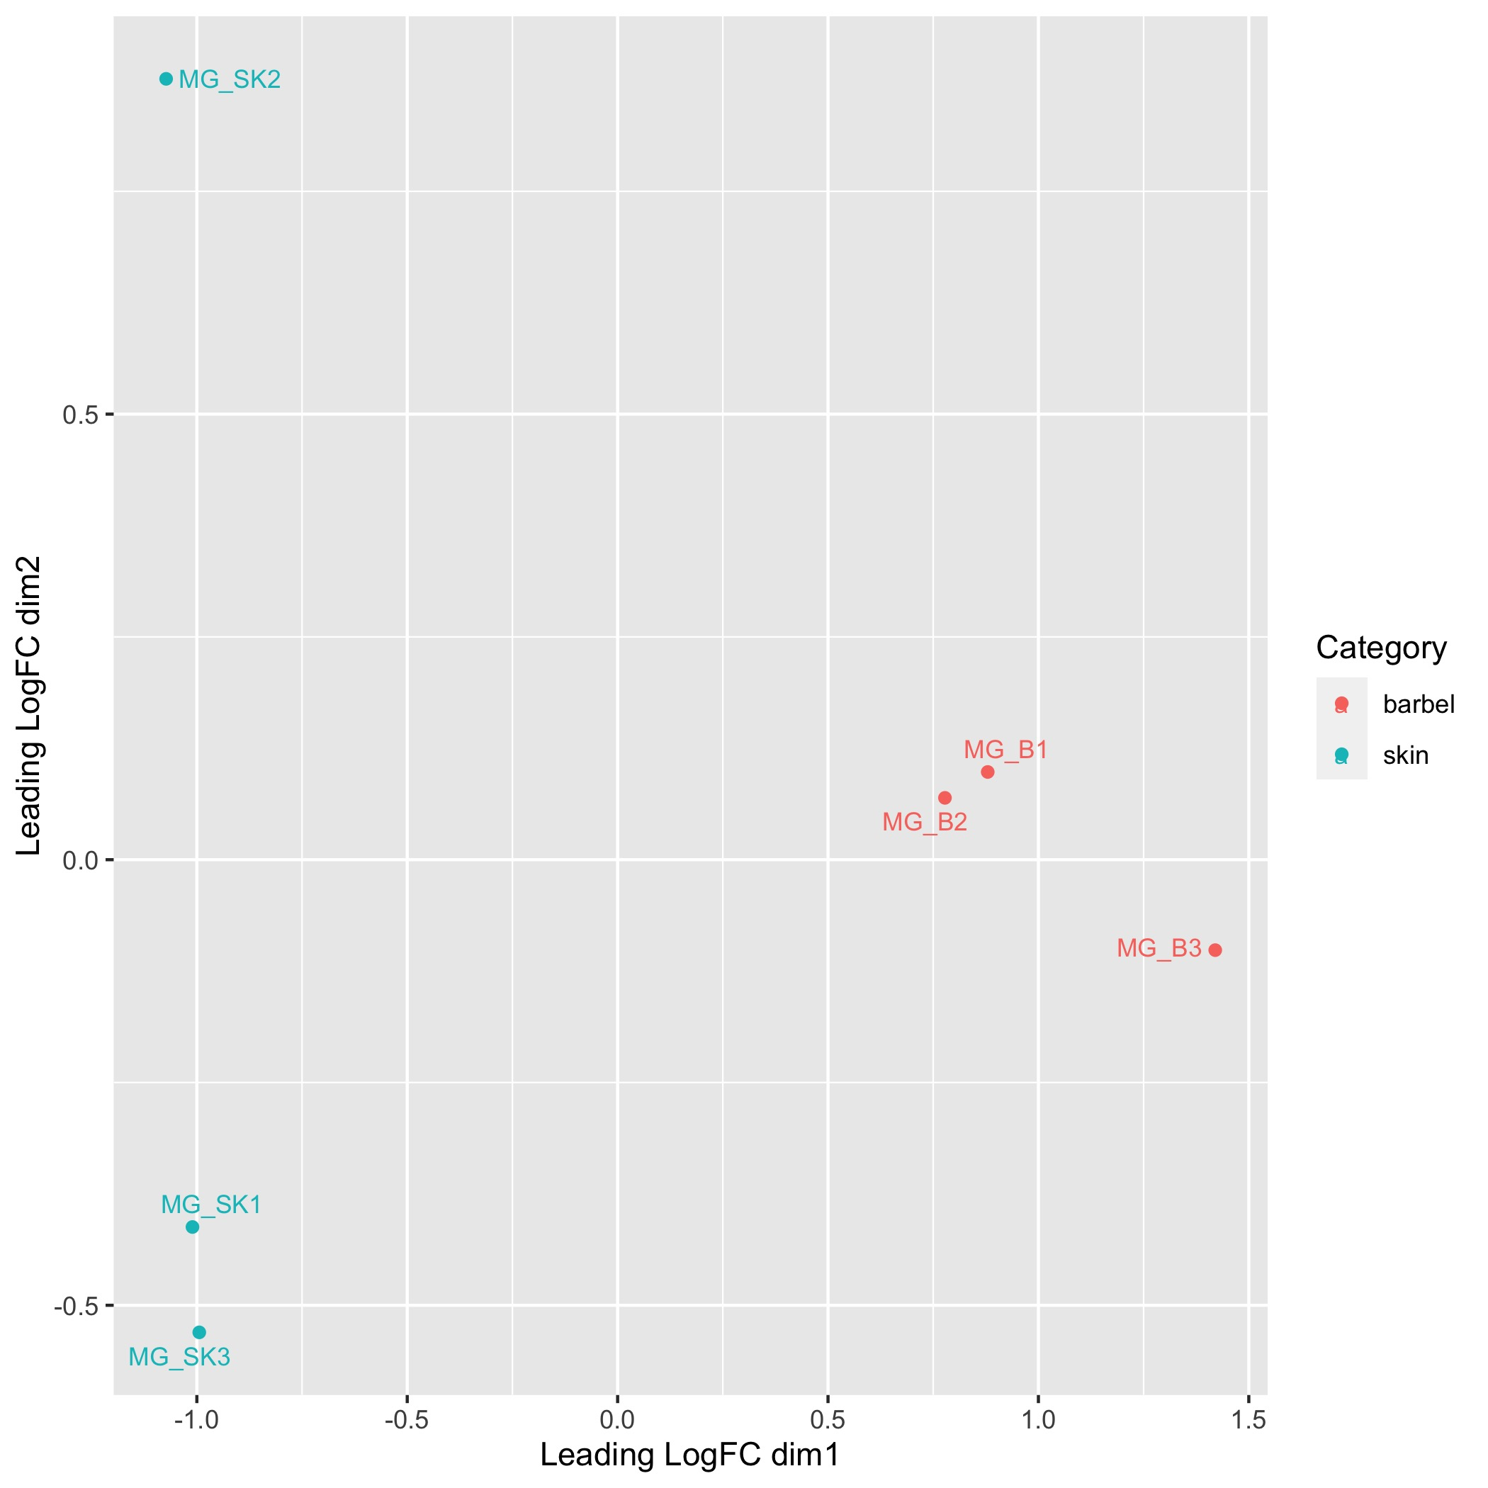
RNAseq Visuals: Quality (RStudio)
MDS Plot
Depicts samples’ similarity in euclidean space via EdgeR’s plotMDS.DGEList()
greater distance = greater differences in expression
Samples group by tissue, suggests no contamination

Slide 17
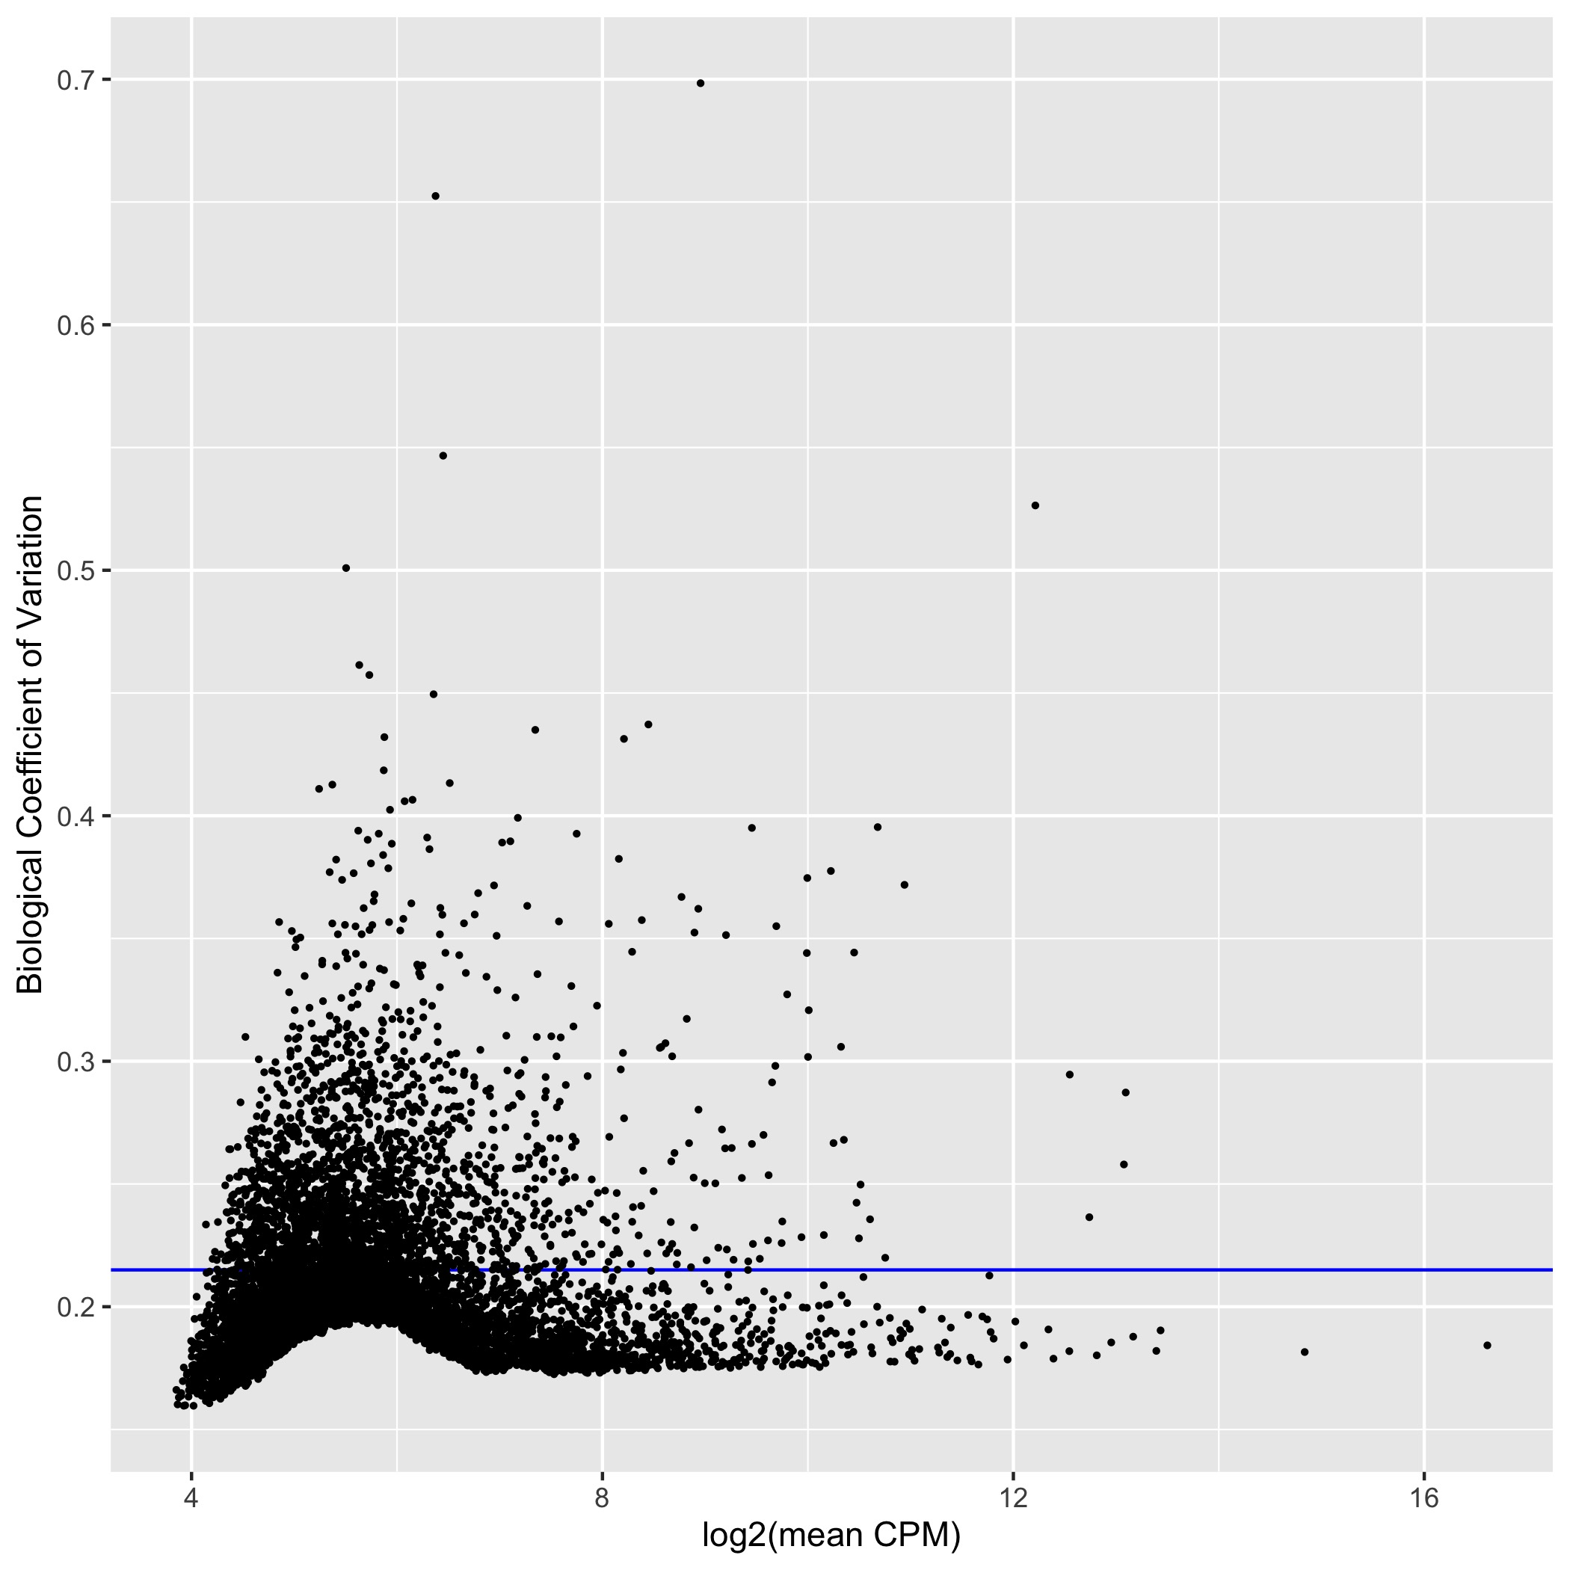
RNAseq Visuals: Quality (RStudio)
Biological Coefficient Variation (BCV) Plot
Takes DGE_object’s AveLogCPM & Sq.Root of tagwise.dispersion
Plots Y-intercept as Sq.Root of DGE_object’s common.dispersion
Shows common (blue) and tagwise/transcript (dots) dispersion
Common of 0.2-0.4 indicates good data (source???)

Slide 18
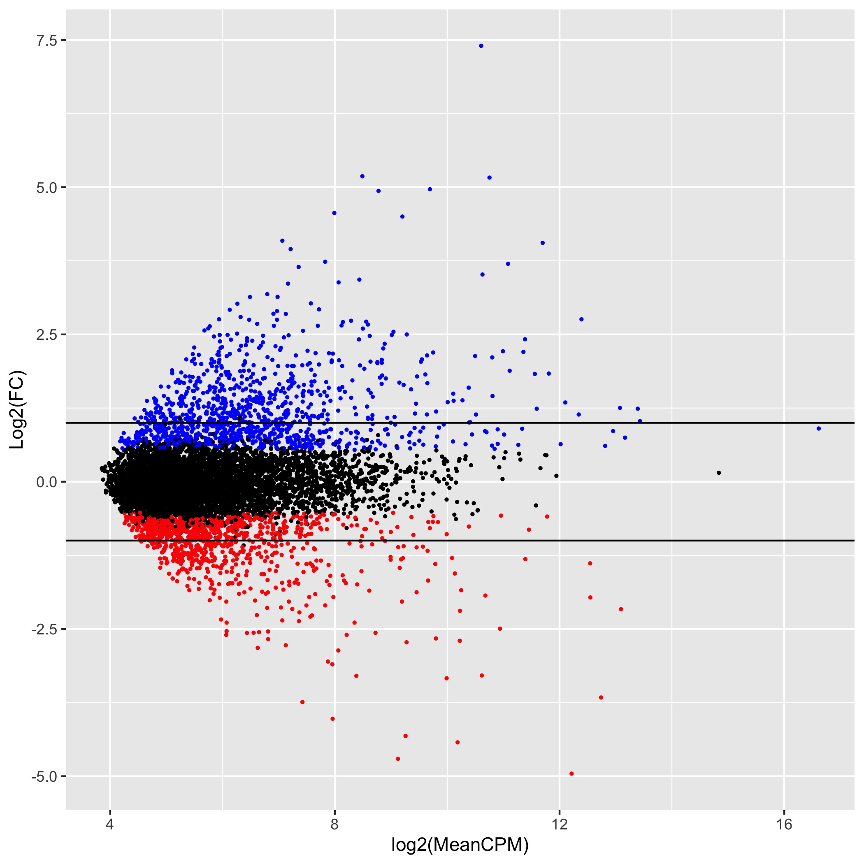
RNAseq Visuals: Expression (RStudio)
MA Plot
Plots Exact Test data
log2 fold change = Exact test fold change values
log2_aveCPM = Exact test logCPM values
Color via decideTestsDGE() data
-/+ 1 fold change often considered notable

Slide 19
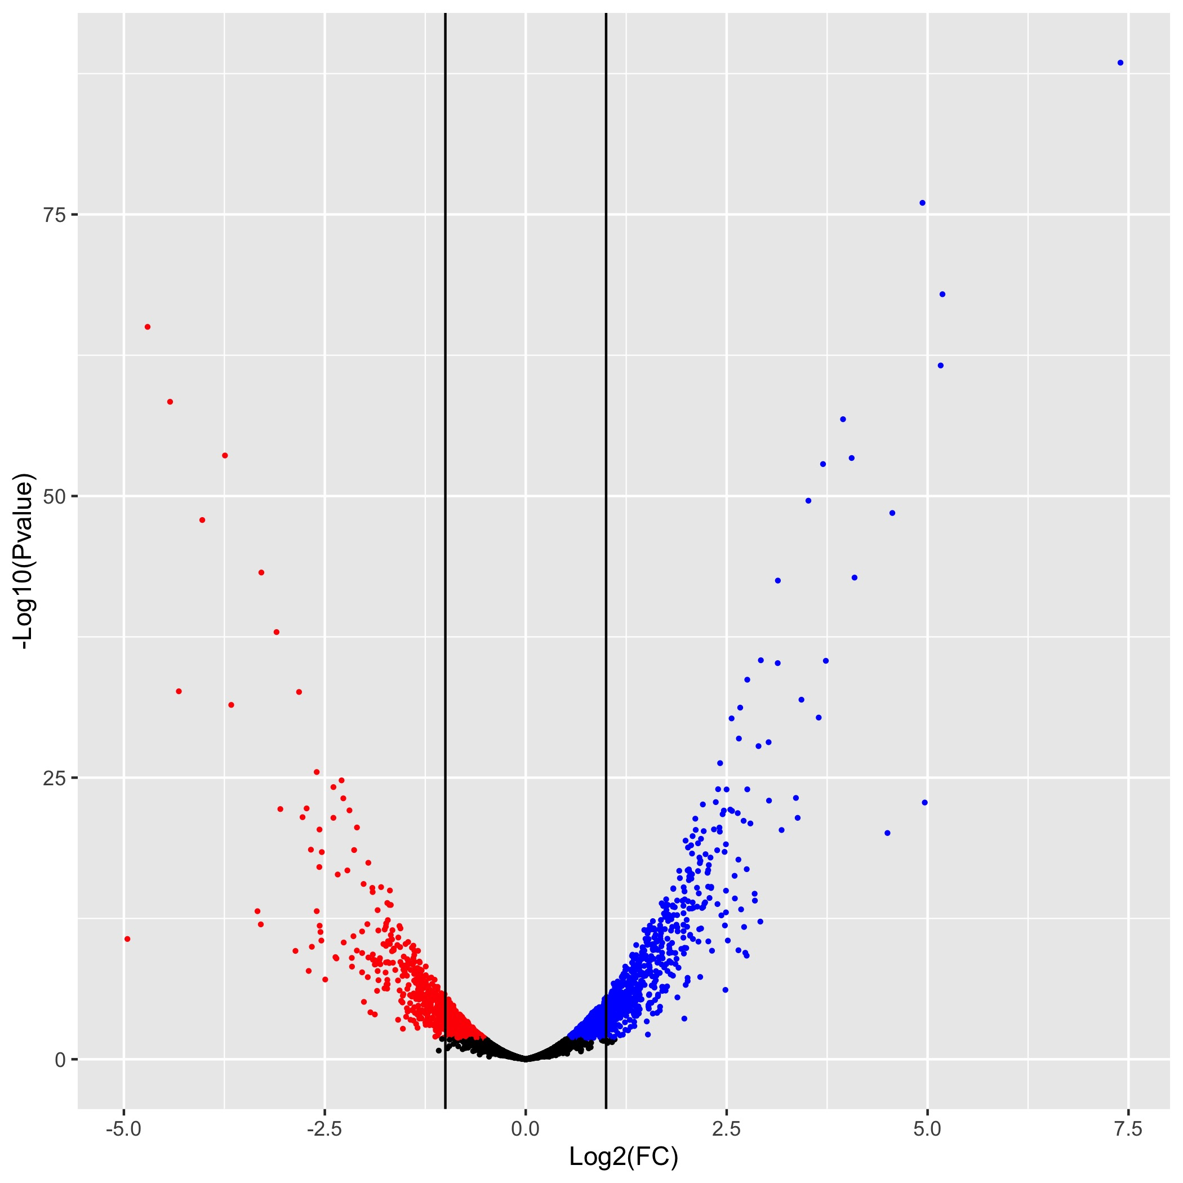
RNAseq Visuals: Expression (RStudio)
Volcano Plot
Plots Exact Test data vs decideTestsDGE() interpretation
log2 fold change = Exact test fold change values
log10 adjustment of exact test’s P-values
Color via decideTestsDGE() data
-/+ 1 fold change often considered notable

Slide 20

Questions or Comments?
If interested in an accessing this code:
https://github.com/C-gonz/RNAseq_plots

